Slide 1

GST

Slide 2
What is GST?
Goods And
Service
Tax
Before GST:
Now:
Advertisement Tax
Excise Duty
Purchase Tax
GST
Entertainment Tax
State VAT
Luxury VAT
Entry Tax
Central Sales Tax

Slide 3
What are the categories of GST?
CGST
SGST
IGST
Central GST
Applicable in all cases
State GST
Applicable in all cases
Integrated GST
Applicable when goods or services are provided inter-state

Slide 4


Who needs to register for GST?
I provided tiffins for office going people. Do I have to register for GST?
Only if your income is more than 20 Lakhs per year
(2018-2019)

Slide 5

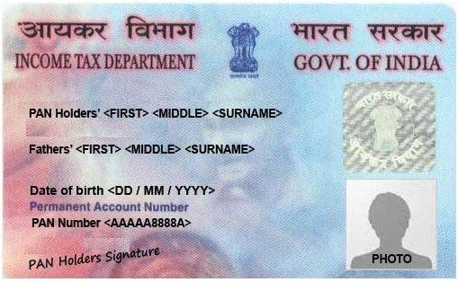
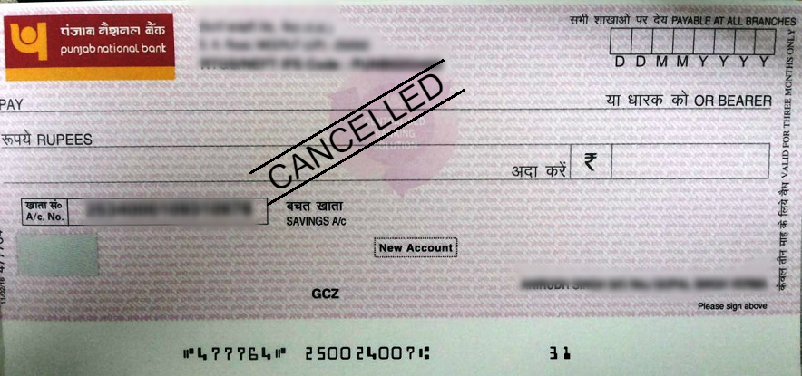

What documents are required for registration?
PAN Card
Permit from the Government to run a commercial establishment
Eg. Shop Act
You run your business from where you say you run your business
Eg. Utility bill / Property Tax receipt
You live where you say you live
Eg. Aadhar Card
You are who you say you are
Eg. Aadhar Card
Proof of Identity
Proof of Address
REGISTRATION IS FREE
Business Registration Document
Address of proof of place of business
Bank Account Proof

Slide 6
What is a GSTIN?
GST Identification Number
It is a 15 character registration number given to a supplier
22
AAAAA0000A
1Z5
State Code
PAN Number

